Slide 1
Cloud Computing Fundamentals
IN401 – M1S1 – 5 Credits

Slide 2
Course Grading
Partial Exam
Final Exam
Second Session
Notes:
Tools not only
Confusing
Difference between papers and books

Slide 3
Course Contents
Chapter 1: Introduction to Cloud Computing
Chapter 2: Infrastructure as a Service (IaaS)
Chapter 3: Platform as a Service (PaaS)
Chapter 4: Software as a Service (SaaS)
Chapter 5: Cloud Native Technologies & Architectures
Chapter 6: Cloud Security
Chapter 7: Practical Case Studies

Slide 4
Chapter 5:
Cloud Native Technologies & Architectures

Slide 5
Content
Introduction
Microservices, API gateways
Container orchestration overview (Kubernetes introductory)
Serverless computing basics (Functions as a Service: AWS Lambda, Azure Functions)

Slide 6
Introduction
What is Cloud Native?
Problems with traditional approach (How Cloud Native address these issues).
Architecture

Slide 7
Cloud Native Definition
Cloud-native refers to an approach for building and running applications that fully leverage the benefits of cloud computing.
Instead of simply hosting traditional applications on cloud servers, cloud-native applications are designed specifically for the cloud environment from the start.

Slide 8
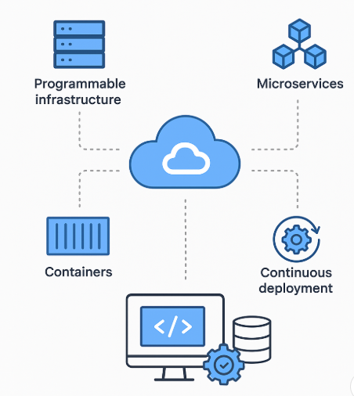
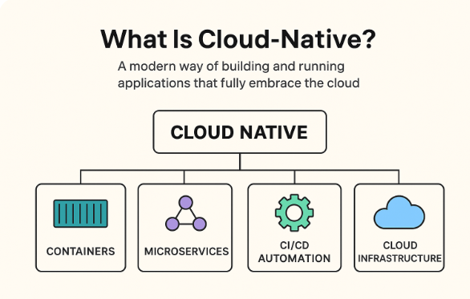
Cloud Native Definition
Cloud-native is an architecture and development methodology that focuses on building scalable, resilient, and flexible applications using cloud technologies.

Slide 9
Cloud Native – Real examples
Netflix
Facebook / Meta
Airbnb
Uber
UberEats
Tesla
Instagram
….

Slide 10
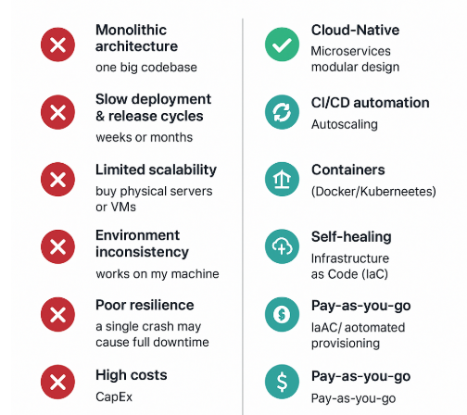
Problems with Traditional approach

Slide 11
1. Monolithic Architecture
Traditional apps are usually one big codebase.
Any small change requires redeploying the entire application.
Hard to scale—must scale the whole system, not individual components.
Failure in one part can crash the whole app.
👉 Cloud-native uses microservices, so changes and failures are isolated.

Slide 12
2. Slow Deployment & Release Cycles
Releases happen every weeks or months.
Manual deployments increase risk and effort.
Hard to adopt automation.
👉 Cloud-native uses CI/CD and DevOps practices for fast, automated, safe deployments.

Slide 13
3. Limited Scalability
Scaling requires buying physical servers or VMs.
Scaling is manual, slow, and expensive.
Resources remain unused when traffic decreases (over-provisioning).
👉 Cloud-native apps scale automatically (horizontal/vertical autoscaling).

Slide 14
4. Environment Inconsistency
“Works on my machine” problems are common.
Different OS, libraries, and configs across dev, test, and prod.
👉 Cloud-native uses containers (Docker) and orchestration (Kubernetes), ensuring consistency everywhere.

Slide 15
5. Poor Resilience
Traditional systems are not built for failure.
A single crash may cause full downtime.
Limited ability to restart or self-heal.
👉 Cloud-native systems have self-healing, redundancy, and fault tolerance built-in.

Slide 16
6. Manual Infrastructure Management
Requires manual server provisioning.
Long setup times (days or weeks).
High operational workload for the team.
👉 Cloud-native uses Infrastructure as Code (IaC) and automated provisioning.

Slide 17
7. High Costs
Must buy servers upfront (CapEx).
Pay even when traffic is low (always-on resources).
Scaling requires hardware purchases.
👉 Cloud-native is pay-as-you-go, optimized for cost efficiency.

Slide 18
Cloud Native – Core Characteristics
1. Microservices Architecture
Applications are broken into small, independent services that can be deployed, scaled, and updated separately.
2. Containers
Microservices are packaged inside containers for portability and consistent environments.
3. Dynamic Orchestration
Platforms like Kubernetes automatically manage scaling, deployment, healing, and load balancing.

Slide 19
Cloud Native – Core Characteristics
4. Elastic Scalability
Applications automatically scale up/down based on demand.
5. Resilience
If one microservice fails, the whole application does not crash; self-healing and redundancy are built-in.
6. DevOps + Automation
Automated pipelines for testing, deployment, monitoring, and rolling updates.
7. Cloud Services
Uses managed services (databases, messaging, storage, API gateways…).

Slide 20
Cloud Native Technologies
Cloud-native technologies are the tools and platforms that help you build applications designed specifically to run in the cloud—not on traditional servers.
These technologies are:
Layers:
1-Microservices
2-Serverless
3-API Gateway
4-Service Mesh
5-Cloud Native DB
Execution Environment:
6-Containers (Docker)
7-Orchestration (Kubernetes)
Platform & Automation:
8-DevOps practices
9-Infrastructure as Code (IaC)
10-Continuous Integration & Continuous Deployment (CI/CD)

Slide 21
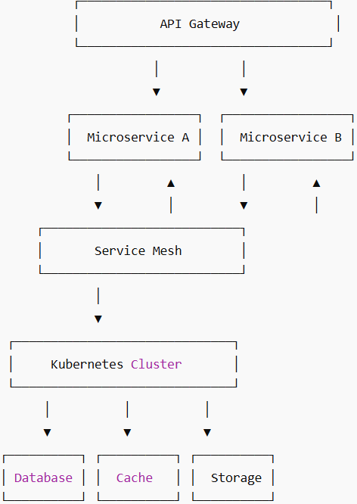
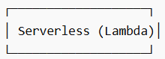

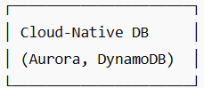
Architectural Flow – Layers
Application Layer:
1-Microservices → main business logic
2-Serverless → used for event-driven
or background tasks
Entry Point Layer:
3-API Gateway → receives client requests → routes to microservices or serverless functions
Communication Layer:
4-Service Mesh (Istio/Linkerd) → manages traffic between microservices → ensures security (mTLS), retries,
load balancing
Data Layer:
5-Cloud-Native Database → scalable, distributed, fully managed

Slide 22
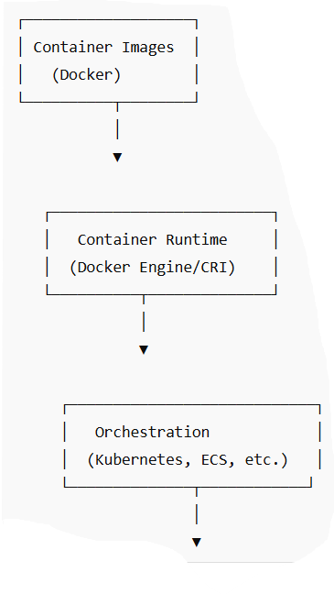
Architectural Flow – Execution Environment
6-Containers (Docker) → Package microservices
Container Runtime → Runs containers on nodes
7-Orchestration (Kubernetes) → Deploys, scales, heals containers

Slide 23
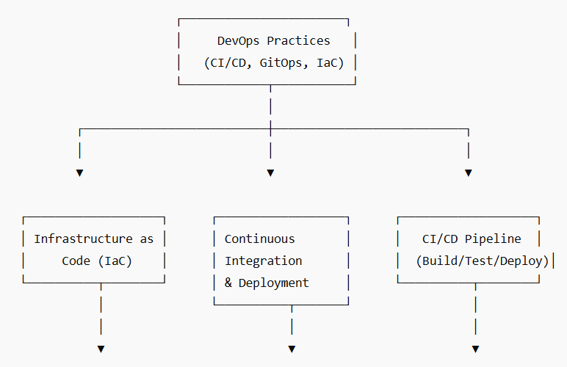
Architectural Flow – Platform & Automation
8-DevOps practices
→ Overarching culture + tools enabling automation and reliability
9-Infrastructure as Code (IaC)
→ Creates the underlying infrastructure
10-Continuous Integration & Continuous Deployment CI/CD
→ Builds and deploys microservices and serverless code

Slide 24
1 – Microservices

Slide 25
What Are Microservices?
Microservices is an architectural style where an application is divided into many small, independent services.
Each service:
performs a single business function
can be developed, deployed, and scaled independently
communicates with other services via APIs
It is the opposite of a monolithic architecture.

Slide 26
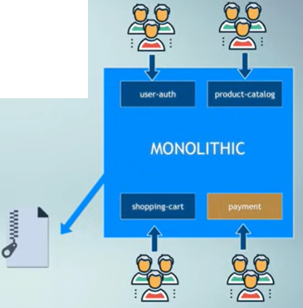
Monolithic Architecture
A monolithic architecture is a traditional software design where the entire application is built as one large, tightly integrated unit.
All components—UI, business logic, and database access—are combined into a single codebase and deployed together.

Slide 27
Disadvantages of Monolithic Architecture
1. Poor Scalability
You must scale the whole application—even if only one part needs more resources.
2. Difficult to Maintain
As the app grows, the codebase becomes large, complex, and hard to understand.
3. Tight Coupling
A small change can affect many other modules.

Slide 28
Disadvantages of Monolithic Architecture
4. Slow Deployment
You must redeploy the entire application for any update.
5. Not Fault Tolerant
One small component failure may cause the entire system to fail.
6. Technology Lock-In
Since everything is one project, it's hard to adopt new tech/languages.

Slide 29
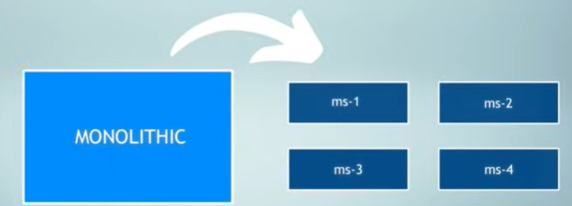
Microservices: Breaking down
Split monolithic (1 codebase into many ms-i)

Slide 30
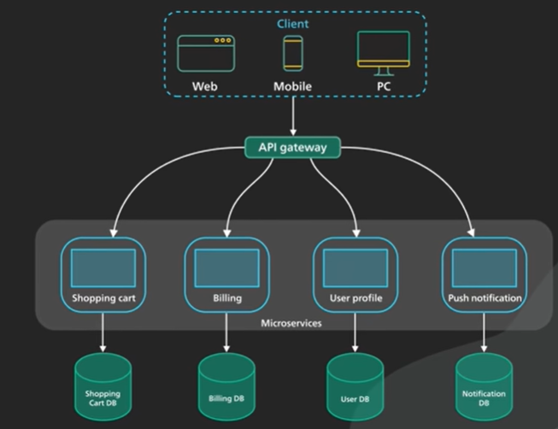
Microservices: Breaking down

Slide 31
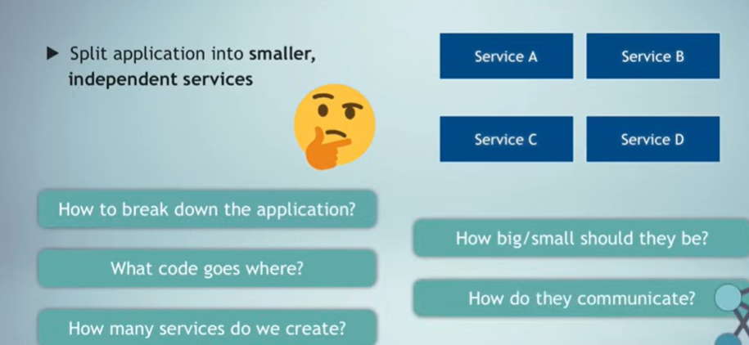
Microservices: Breaking down

Slide 32
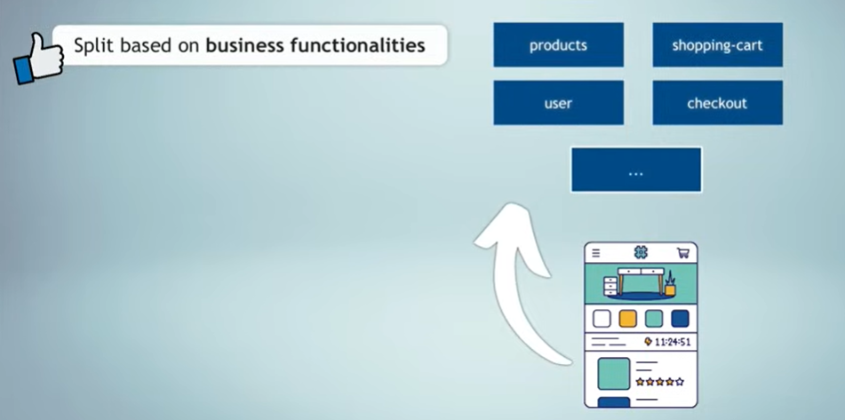
Q1: How to break down the application?

Slide 33
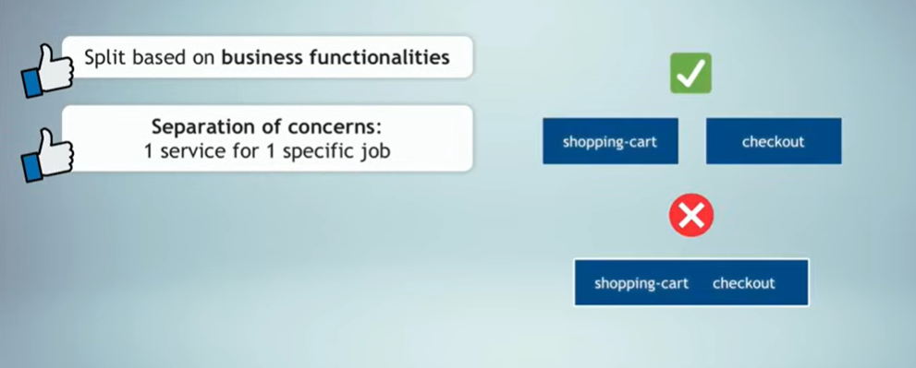
Q2: How big or small they should be? Q3: How many microservices?

Slide 34
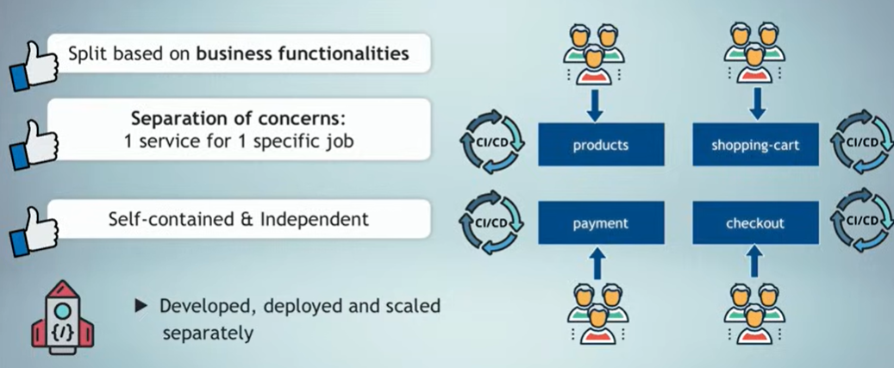
Q4: What code goes where? (Loosely coupled)

Slide 35
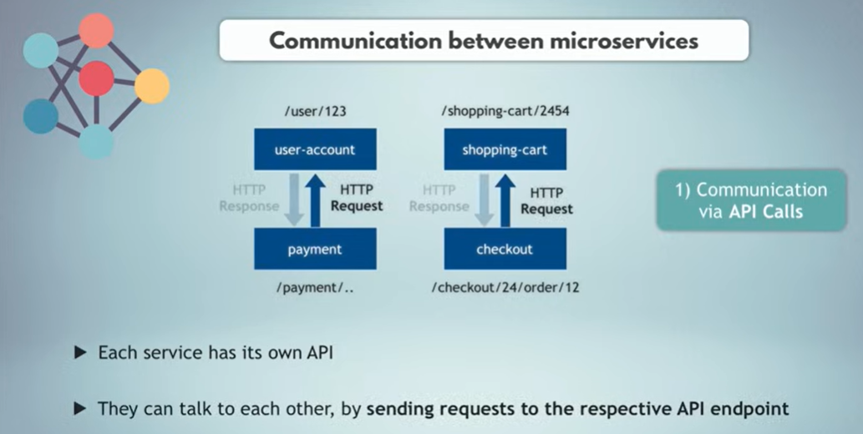
Q5: How do they communicate?
1) Synchronous Communication (via API Calls)

Slide 36
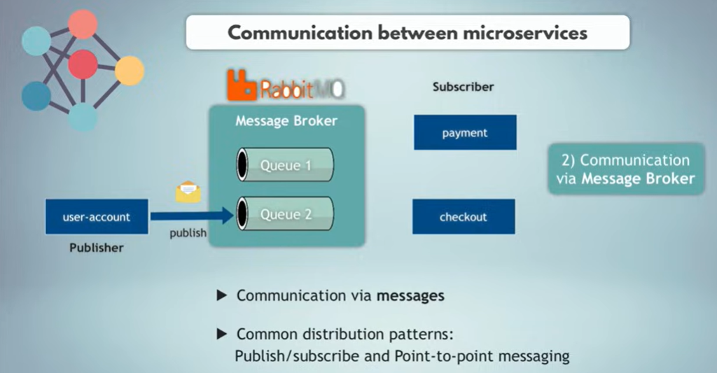
Q5: How do they communicate?
1) Asynchronous Communication (via Message Broker)

Slide 37
Advantaged of Microservices
1. Scalability
Scale each service independently (e.g., scale Payment without scaling User).
2. Faster Development
Different teams develop different services. Improves productivity.
3. Flexibility
Use different languages/technologies per service.
4. Fault Isolation
If Order service fails, User service continues working.
5. Continuous Deployment
Small services → fast deployment, minimal risk.

Slide 38
Disadvantaged of Microservices
1. Increased Complexity
Many small services = complex network.
2. Harder Debugging and Monitoring
Distributed logs and errors.
3. Network Latency
Services talk over the network → delays possible.
4. Data Consistency Challenges
Each service has its own DB → needs eventual consistency.
5. Requires DevOps Expertise
Automation, CI/CD, container orchestration (K8s) required.

Slide 39
2 – Serverless (Functions as a Service: AWS Lambda, Azure Functions)

Slide 40
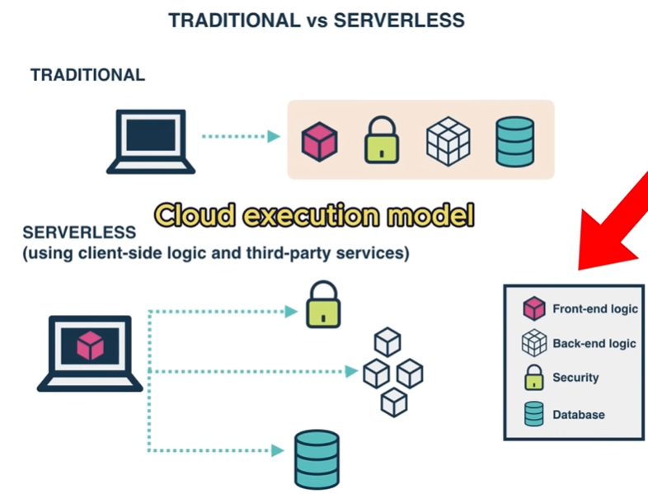
Serverless computing
Serverless computing allows you to run code without provisioning or managing servers. You only upload functions; the cloud handles everything else.
Though servers exist, they are fully hidden from the developer.

Slide 41
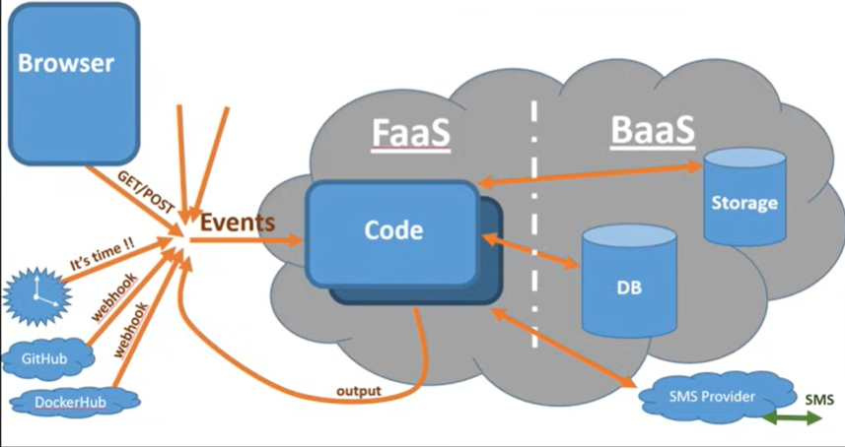
Serverless computing
Serverless = Function as a Service (FaaS) + Backend as a Service (BaaS).

Slide 42
Serverless – FaaS, BaaS
FaaS is a cloud-native compute model that lets you deploy small, single-purpose pieces of code — called functions — that execute only when triggered.
you pay only for the time the function runs.
BaaS platforms give developers prebuilt backend functionality, accessible via APIs, such as:
Authentication & authorization
Database & storage
File handling
Analytics & logging
Hosting
API management, …

Slide 43
Serverless computing – Key Features
1-No server management → you don’t provision or maintain servers. No patching, no OS updates, no cluster management.
2-Automatic scaling → scales instantly based on traffic, scales up during high traffic and scales to zero when idle.
3-Pay-per-use → you pay only for execution time, not idle time. Billing is based on:
Number of requests
Execution time
Memory/CPU usage

Slide 44
Serverless computing – Key Features
4-Event-driven → functions run in response to triggers:
HTTP requests
Database changes
Messaging queues
File uploads
Scheduled events
5-Stateless → functions are stateless. No stored session data on the server. State is stored in databases, caches, or storage services.

Slide 45
Serverless – Disadvantages
Cold starts (delay on first request)
Limited execution time
Vendor lock-in
Harder debugging for distributed functions
Stateless by design

Slide 46
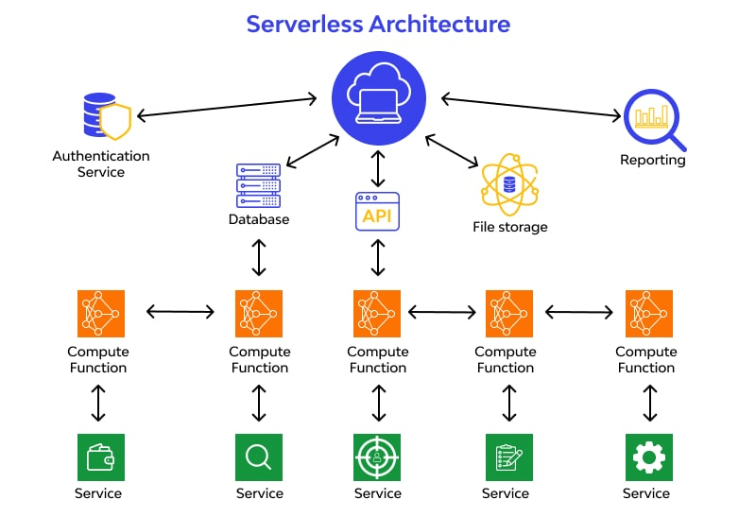
Serverless – Architecture Components
Event sources (API Gateway, queues, cron, file upload triggers)
Authentication services
Serverless databases
Functions (compute)
Monitoring
Reporting

Slide 47
Serverless – Services
Compute
AWS Lambda
Azure Functions
Google Cloud Functions
Cloudflare Workers
Serverless Containers
AWS Fargate
Google Cloud Run
Azure Container Apps

Slide 48
Serverless – Services
Serverless Databases
DynamoDB
Aurora Serverless
Firestore
Cosmos DB
Serverless Storage
Amazon S3
Google Cloud Storage

Slide 49
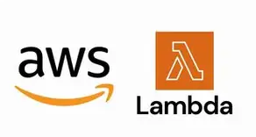
Serverless computing – AWS Lambda
Runs small pieces of code in response to events i.e. when triggered by:
API Gateway request
File upload to S3
Message in queue
Cron-like schedules
Database changes
You upload your function code, and Lambda executes it on-demand, scaling automatically.

Slide 50
Serverless computing – AWS Lambda
How AWS Lambda Works:
You write a function (Python, Node.js, Java, Go, .NET, Ruby, etc.).
Deploy it to AWS Lambda.
Configure an event trigger.
Lambda runs the function only when needed.
You only pay for the duration your function runs (ms-based). However, you have only 15-minute maximum execution time.

Slide 51
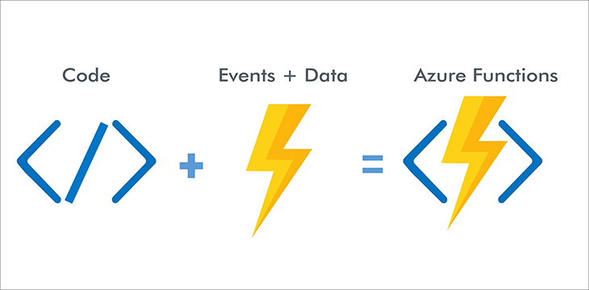
Serverless computing – Azure Functions
Azure Functions is Microsoft Azure’s serverless compute service that lets you run code on-demand without managing servers.
It follows an event-driven model just like AWS Lambda.

Slide 52
Serverless computing – Azure Functions
How Azure Functions Works:
Write a function (C#, Python, JavaScript, Java, PowerShell, etc.)
Deploy it to Azure Functions.
Bind it to a Trigger (something that starts the function).
(Optional) Use Bindings to integrate with other Azure services.
Azure runs the function only when needed and scales automatically.

Slide 53
3 – API Gateways

Slide 54
API Gateways
An API Gateway is a critical component in a microservices architecture, acting as a single-entry point for client requests.
It simplifies communication between clients and multiple microservices by managing routing, security, and protocol translation.
This approach enhances scalability, security, and performance in cloud systems.

Slide 55
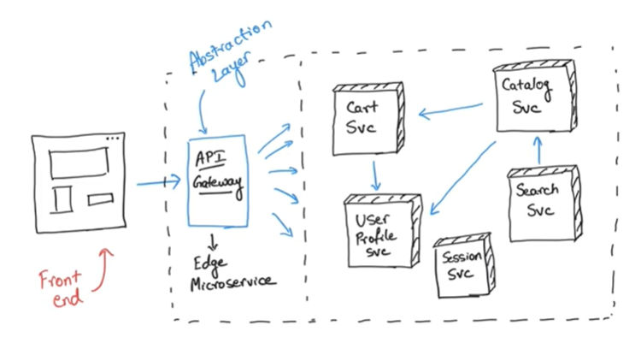
API Gateways

Slide 56
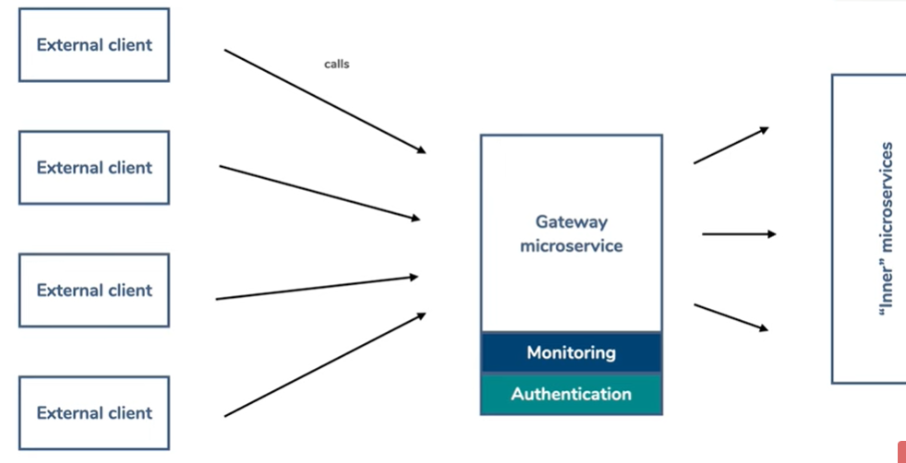
API Gateways

Slide 57
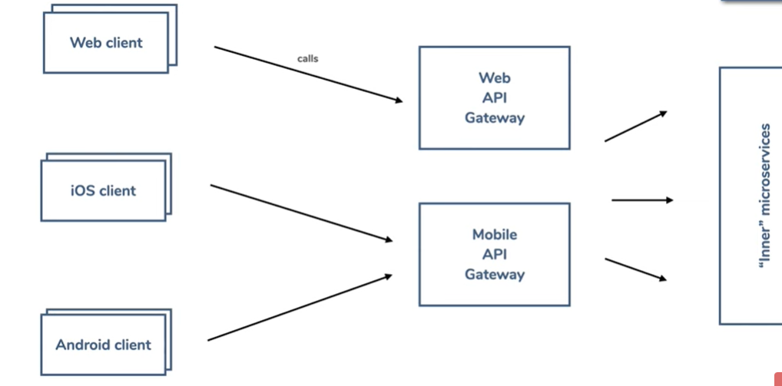
API Gateways

Slide 58
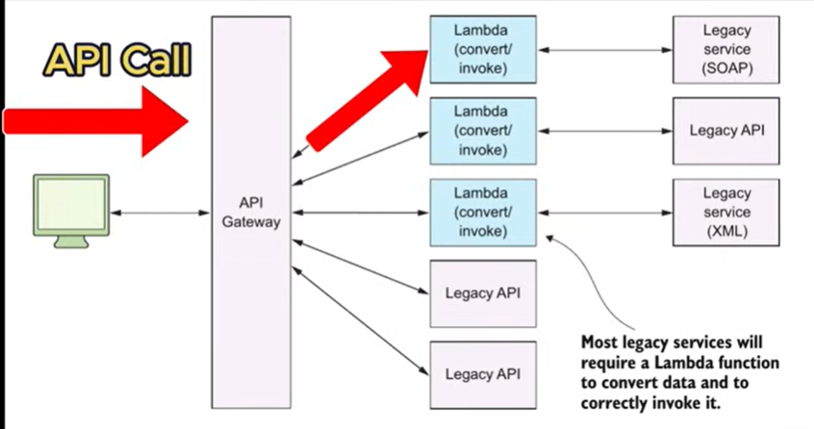
Route and invoke the correct Lambda

Slide 59
Key Features of an API Gateway
Routing and Load Balancing: It routes client requests to the appropriate microservice based on predefined rules and balances the load across multiple service instances to ensure reliability and scalability.
Protocol Translation: It translates protocols (e.g., HTTP to gRPC) and data formats to ensure compatibility between clients and backend services.
Request Transformation: It modifies incoming requests or outgoing responses, such as altering headers, parameters, or payloads, to meet backend service requirements.

Slide 60
Key Features of an API Gateway
Caching: It caches frequently requested data to reduce latency and improve response times, minimizing the load on backend services.
Security: It centralizes security measures like authentication, authorization, and encryption, reducing the burden on individual microservices.

Slide 61
Benefits of Using an API Gateway
Centralized Management: It provides a unified entry point, simplifying traffic management, security policies, and API monitoring.
Improved Security: It enforces authentication, authorization, and SSL termination, protecting microservices from direct exposure.
Scalability: It distributes requests across service instances, ensuring high availability and optimal resource utilization.
Protocol Agnosticism: It allows clients to use their preferred protocols, enabling seamless integration with diverse systems.
Performance Optimization: It reduces network overhead by aggregating responses from multiple microservices into a single response.

Slide 62
Common API Gateway Patterns
Gateway Aggregation: Combines responses from multiple microservices into a single response, reducing client-server interactions. For example, an e-commerce platform can aggregate product, payment, and shipping APIs into one endpoint.
Gateway Offloading: Offloads tasks like authentication, rate limiting, and request validation to the gateway, reducing the complexity of individual microservices.
Gateway Routing (Backend for Frontend (BFF)): Directs requests to the appropriate microservice based on URL paths, headers, or metadata. Different gateways for mobile/web/IoT. For instance, requests for product details are routed to the product catalog service.

Slide 63
Common API Gateway Patterns
Gateway Transformation: Modifies requests or responses to ensure compatibility between clients and services, such as converting JSON to XML or enriching responses with additional metadata.
Gateway Security (Edge Proxy Pattern): Gateway normally sits at cloud edge for performance/security. It implements security measures like OAuth, SSL/TLS encryption, and input validation to protect microservices from unauthorized access and attacks.

Slide 64
Challenges
Complexity
Single point of failure
Should ensure high availability, scalability, and robust monitoring to mitigate these risks !!

Slide 65
4 – Service Mesh

Slide 66
Service Mesh
A service mesh is a dedicated infrastructure layer that manages communication between microservices automatically due to the need of secure, reliable, and observable communication at scale.
It Provides:
Secure service-to-service communication (mTLS)
Traffic management (routing, retries, circuit breaking)
Observability (metrics, logs, tracing)
Policy enforcement
Zero-trust networking
Service discovery
Load balancing

Slide 67
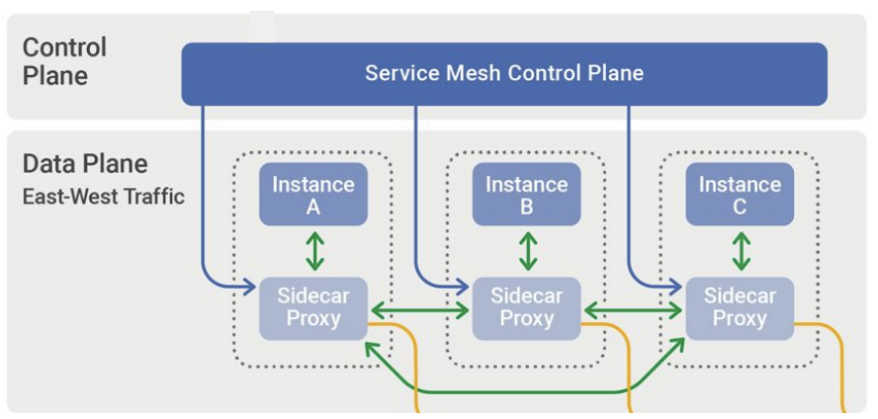
Service Mesh
It Uses sidecar proxies (e.g., Envoy) that handle communication for each service:
Each microservice instance runs with a lightweight proxy (sidecar).
All inbound/outbound traffic goes through the proxy.
Mesh control plane configures these proxies.

Slide 68
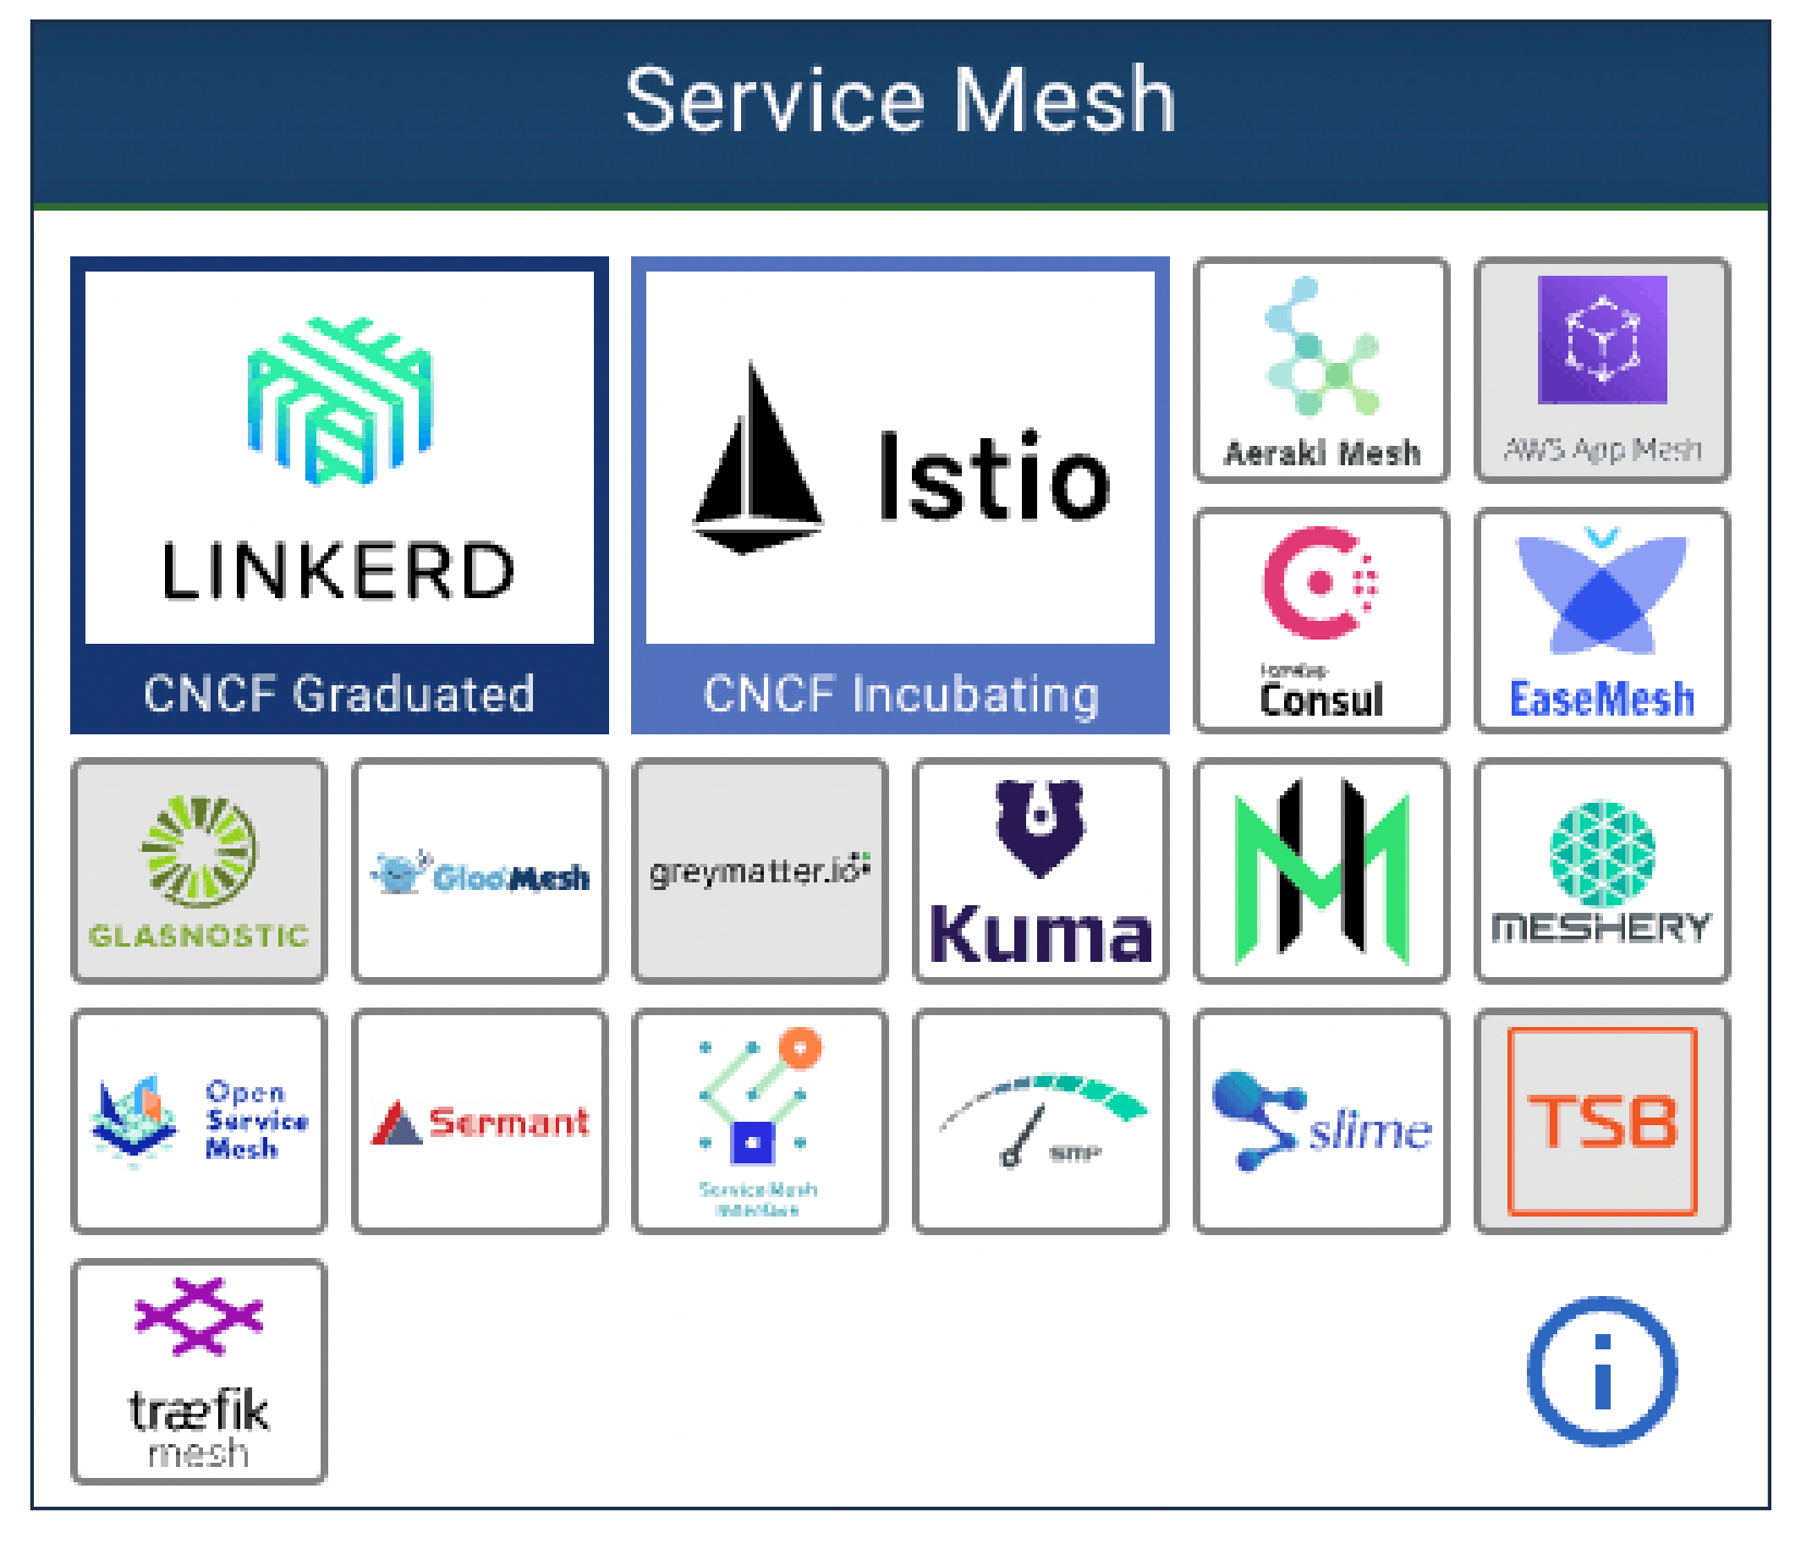
Service Mesh – Examples

Slide 69
5 – Cloud-Native Database

Slide 70
Cloud-native Database
A cloud-native database is designed to run optimally in cloud environments—scalable, distributed, and resilient by default.
Each microservice typically uses:
its own database (Database per Service pattern)
often independent storage engines
accessed over APIs rather than shared direct queries

Slide 71
Cloud-native Database – Characteristics
Fully managed by the cloud provider
Auto-scaling and high availability
Distributed architecture across nodes or regions
Pay-as-you-go pricing
Self-heal, Integrated backup & monitoring
Update without downtime
Handle massive workloads
Integrate deeply with cloud platforms

Slide 72
Cloud-native Database – Types
🔸 Distributed SQL Databases
Provide SQL + horizontal scalability.
Examples: Google Cloud Spanner, YugabyteDB, CockroachDB, Amazon Aurora Serverless, Azure Cosmos DB (SQL mode)
🔸 NoSQL Cloud Databases
Designed for massive scale and high throughput.
Examples: DynamoDB, Cassandra (AstraDB), MongoDB Atlas, Cosmos DB (Mongo/NoSQL APIs), Bigtable
🔸 Serverless Databases
Scale automatically to zero when idle.
Examples: Aurora Serverless V2, DynamoDB On-Demand, PlanetScale

Slide 73
6 – Containers (Docker)

Slide 74
Containers
A container is a lightweight, portable environment that packages an application with all its dependencies.
It Works the same everywhere (no “it works on my machine” issues), Fast to start, Uses fewer resources than virtual machines, Ideal for microservices
Docker is the most commonly used containerization platform.
Key Concepts:
Image → template
Container → running instance
Dockerfile → instructions to build an image
Docker Hub → image repository

Slide 75
7 – Orchestration (Kubernetes)

Slide 76
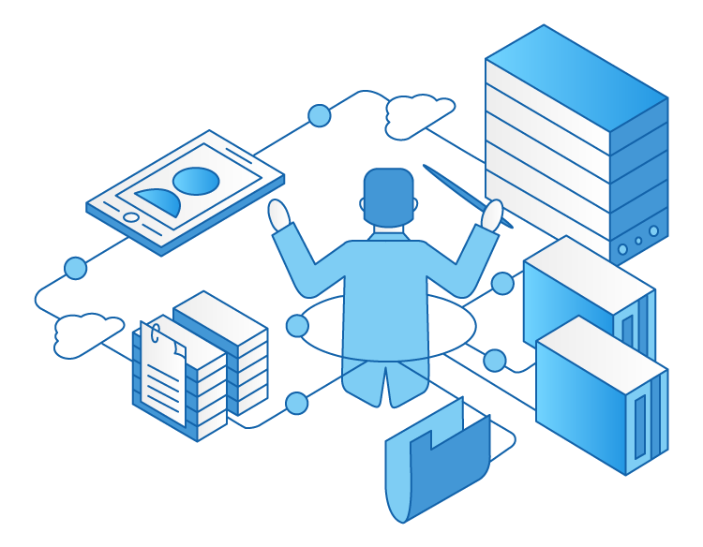
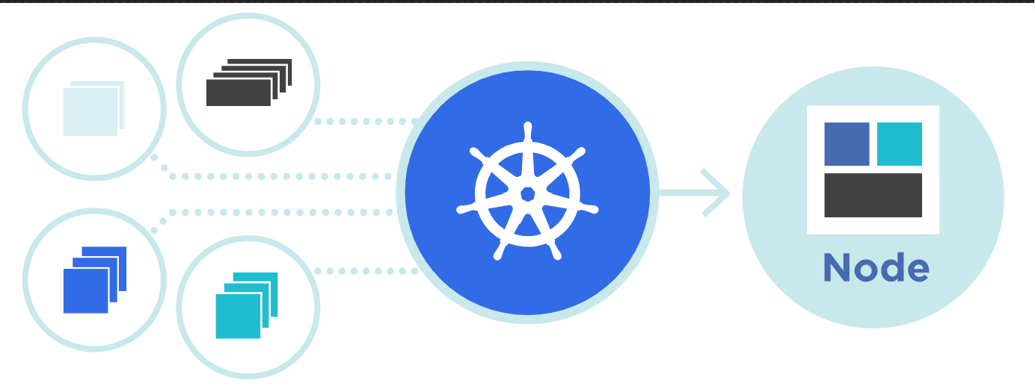
Orchestration (Kubernetes)
Orchestration is the automated management of containerized applications—handling deployment, scaling, networking, and lifecycle.
Kubernetes (K8s) is the most widely used container orchestration platform. Used when you have many microservices running in containers, where manual management becomes impossible.

Slide 77
Orchestration (Kubernetes)
Before orchestration, teams faced challenges:
Managing dozens or hundreds of containers
Restarting crashes manually
Handling traffic routing
Scaling services during peak load
Managing updates without downtime
Coordinating microservices communication
Kubernetes automates all of this.

Slide 78
Application Deployment Evolution
2000s: Physical servers → slow provisioning, snowflake servers
2010–2014: Virtual machines → faster but still heavy
2013–2016: Containers (Docker) → lightweight, portable runtime
Today: Kubernetes → orchestration, automation, scalability, resilience
2014: Kubernetes open-sourced by Google
2015: Donated to the CNCF (Cloud Native Computing Foundation)
2017+: Explosion in adoption → major cloud providers adopt it as a managed service

Slide 79
Core Responsibilities of Kubernetes as an Orchestrator
1. Automated Deployment & Scheduling
Decides where containers should run based on CPU, RAM, and resource needs
Ensures the application reaches the desired state declared by the developer
2. Scaling (Auto-Scaling)
Horizontal Pod Autoscaler (HPA): replicate Pods based on metrics
Vertical Pod Autoscaler (VPA): adjust Pod resource sizes
Cluster Autoscaler: add/remove nodes based on demand

Slide 80
Core Responsibilities of Kubernetes as an Orchestrator
3. Self-Healing
Automatically restarts failed containers
Replaces unresponsive Pods
Ensures the correct number of replicas
4. Service Discovery & Load Balancing
Services get stable IPs
Traffic is automatically routed to healthy Pods
Nearest or least-loaded Pod receives traffic
5. Rolling Updates & Rollbacks
Update applications with zero downtime
Roll back if the update fails

Slide 81
Core Responsibilities of Kubernetes as an Orchestrator
6. Configuration & Secrets Management
Separates config from code using ConfigMaps
Stores sensitive data in Secrets
7. Storage Orchestration
Automatically mounts persistent storage volumes
Supports cloud storage (EBS, Azure Disk, GCP Persistent Disk)
8. Multi-cloud flexibility

Slide 82
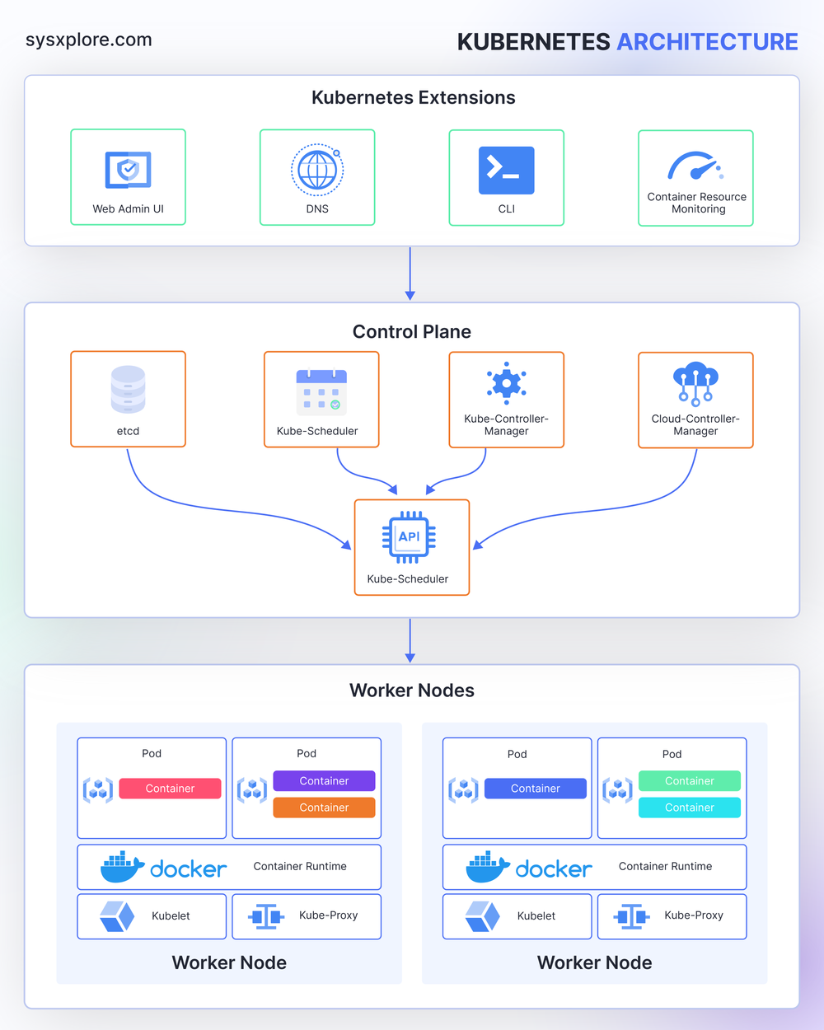
Kubernetes Components

Slide 83
Control Plane – etcd
etcd (The Key-Value Store)
Distributed, strongly consistent (Raft-based)
Stores cluster state, including:
Resource definitions
Secrets (by default base64, not encrypted unless configured)
Configs
Node state

Slide 84
Control Plane – Kube-API
Kube-API Server (The "Front Door")
The only component in Kubernetes that talks to etcd.
All external communication passes through the API server.
Exposes REST endpoints.
Responsible for:
authentication
authorization
admission control
validation
request routing

Slide 85
Control Plane – Kube Controller Manager
Kube Controller Manager
Runs core controllers:
Deployment Controller — ensures correct number of replicas
ReplicaSet Controller
Node Controller
Endpoint Controller
Job Controller
Service Account Controller
Controllers constantly compare desired state (Spec) vs actual state (Status) and take actions until they match.

Slide 86
Control Plane – Cloud Controller Manager
Cloud Controller Manager (CCM)
allows the cluster to integrate with a cloud provider’s infrastructure. It runs only when Kubernetes is deployed on a cloud provider.

Slide 87
Control Plane – Scheduler
Scheduler
Responsible for placing Pods on Nodes.
Scheduling logic overview:
Filter nodes
resources (CPU/Memory)
taints/tolerations
affinity rules
Score remaining nodes
Bind Pod to the selected node

Slide 88
Worker Nodes – Pod
Pod
is a smallest deployable unit.
is a wrapper around one or more containers.
It represents a single instance of a running application in the cluster.
Pod Lifecycle
Pending → waiting for scheduling
Running → one or more containers running
Succeeded / Failed → containers stopped
CrashLoopBackOff → container repeatedly crashes
Terminating → shutting down

Slide 89
Worker Nodes – Kubelet
Kubelet (The Node Agent)
Runs on every node.
is like a supervisor on each worker machine.
Responsibilities:
Ensures containers are running
Watches the API server for Pod specifications
Starts/stops containers using Container Runtime (containerd, CRI-O, etc.)
Reports pod status and resource usage
Executes readiness/liveness/startup probes

Slide 90
Worker Nodes – Container Runtime
Container Runtime
Common runtimes:
containerd
CRI-O
Docker (deprecated as default runtime)
gVisor, Kata Containers for sandboxed workloads
Must implement the CRI (Container Runtime Interface).

Slide 91
Worker Nodes – Kube-Proxy
Kube-Proxy
Networking component.
Functions:
Implements Service abstraction
Automatically manages iptables or IPVS rules
Provides cluster-wide service discovery and load balancing

Slide 92
8 – DevOps practices

Slide 93

DevOps practices
DevOps is a set of cultural principles + practices + tools that improve collaboration between development and operations teams.
Core DevOps Practices:
CI/CD automation
Infrastructure as Code (IaC)
Monitoring & logging
Version control (GitOps)
Automated testing
Continuous feedback
Microservices & containerization
Collaboration and shared ownership

Slide 94
DevOps practices
Goals:
Faster development cycles
More reliable releases
Improved collaboration
High automation
Scalability and stability
Popular DevOps Tools:
Jenkins, GitLab, GitHub Actions
Terraform, Ansible
Kubernetes
Prometheus, Grafana
Docker

Slide 95
9 – Infrastructure as Code (IaC)

Slide 96
What is IaC ?
Infrastructure as Code (IaC) is a modern approach to managing and provisioning IT infrastructure using machine-readable configuration files instead of manual processes.
It allows you to define, deploy, and update infrastructure (servers, networks, databases, load balancers, etc.) using code—similar to how software applications are developed.

Slide 97
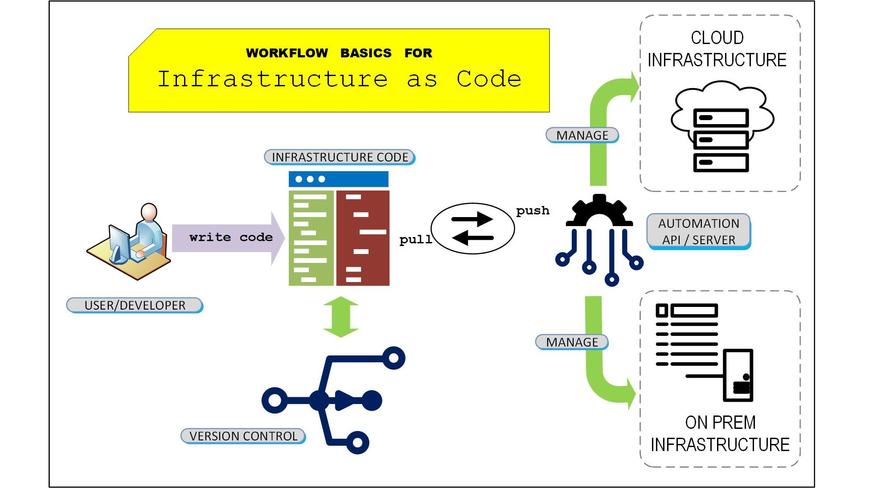
What is IaC ?

Slide 98
IaC Approaches
A. Declarative (WHAT to provision)
You specify the desired final state. The tool figures out how to reach that state.
Terraform
AWS CloudFormation
Azure ARM/Bicep
Kubernetes YAML
B. Imperative (HOW to provision)
You define step-by-step instructions.
Ansible
Puppet
Chef

Slide 99
IaC Workflow
Write configuration code
Validate & test
Commit to version control (Git)
Run provisioning (Terraform apply, ansible-playbook…)
Cloud provider creates the resources
CI/CD pipelines handle updates and deployments

Slide 100
Simple Example (Terraform)
resource "aws_instance" "myserver" {
ami = "ami-067c21fb1979f2d1c"
instance_type = "t2.micro"
}

Slide 101
Benefits of IaC
1. Speed & Automation
Infrastructure can be deployed instantly using scripts instead of manual setup.
2. Consistency & Standardization
Every environment (dev, test, prod) is identical—reduces configuration drift.
3. Version Control
Infrastructure definitions stored in Git → rollback, history, collaboration.

Slide 102
Benefits of IaC
4. Scalability
Automates spinning up multiple servers, clusters, networks, etc.
5. Cost Efficiency
Auto-scaling and automated teardown avoid paying for unused resources.
6. Reusability
Modules and templates help avoid repeating configurations.

Slide 103
10 – Continuous Integration & Continuous Deployment (CI/CD)

Slide 104
CI/CD
CI/CD is a DevOps practice that automates software development, testing, and deployment.
Continuous Integration (CI):
Developers frequently merge code changes into a shared repository.
Automated tests run to ensure code quality.
Continuous Deployment / Delivery (CD):
Automatically deploy code to production (CD) or staging (Delivery) after passing all tests.

Slide 105
CI/CD
Benefits:
Faster releases
Fewer bugs
High automation
Reliable and consistent deployments
Examples of CI/CD Tools:
Jenkins
GitLab CI
GitHub Actions
Azure DevOps
CircleCI

Slide 106
CI/CD
Typical CI/CD Pipeline Workflow:
Developer pushes code
CI triggers: build + tests
Security scans & code quality checks
Create container image
Push image to registry
Deploy to Kubernetes (or VM/server)
Auto tests in staging
Manual/automatic promotion to prod
Monitoring and rollback if needed

